Slide 1
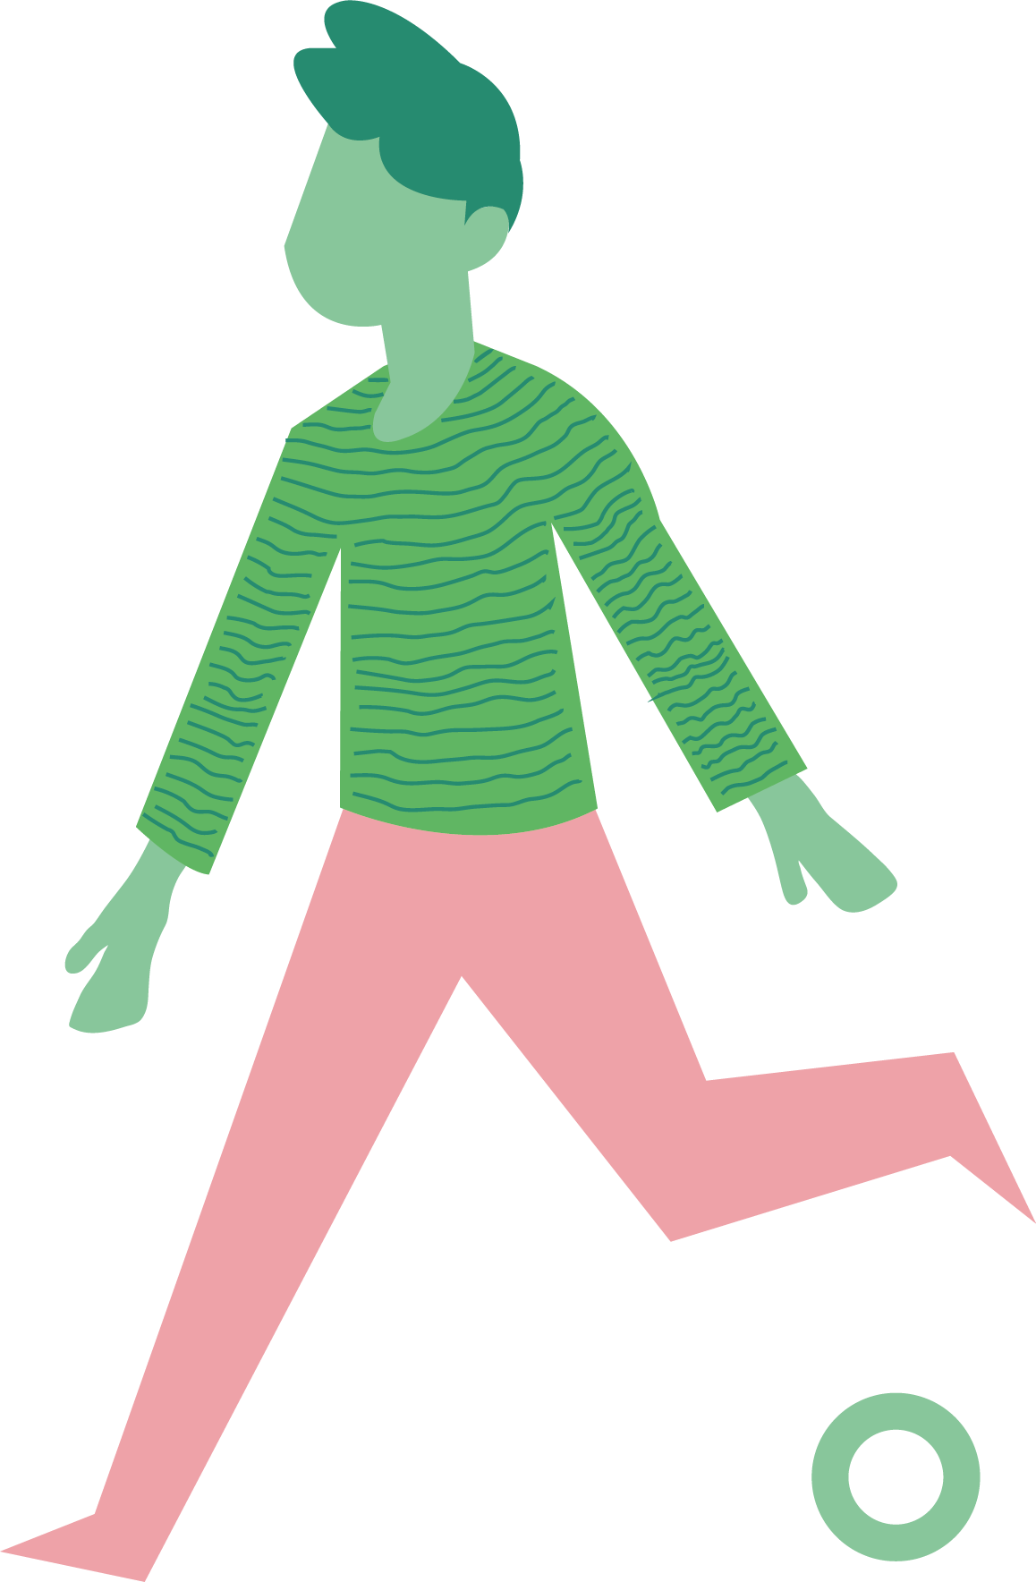
HCD for WASH
AFFINITY MAPPING
STEPS
Prepare your data and team for creating an affinity map. Start with a clear data set, ideally a wall or online whiteboard populated with sticky notes for all data points (completed during storytelling or after research is completed). Ensure all of your team members have shared their data, and that is clearly labeled according to location or type of participant (however it is most appropriate for your research participants).
While you can do this as an individual, it is preferable to complete together as a team so that all team members can engage in the process, interact with the date, and begin to understand the themes emerging.
Begin organizing your sticky notes according to common themes. Start with one sticky note, likely the beginning of one participant’s story, and make it the ‘first’
Go on to the next sticky note, and ask whether it’s similar or different from the first - if it’s different, place it in another area so it will become its own cluster
Continue one by one, placing the sticky notes in different clusters, and creating new ones if a similar theme doesn’t exist yet
As a cluster starts to accumulate multiple stickies, discuss what title most accurately represents them. It should be general, yet specific enough to capture the meaning of the sticky notes without someone needing to read through the whole cluster
As you reach the end of your dataset, you may want to revisit your title names and rename them to more accurately depict on sticky notes. You may also want to divide a cluster into subgroups as more differences emerge.
After conducting research and aggregating all researchers’ findings in one place, team members can use affinity mapping as a starting point for analysis. Regardless of the type of findings or size of the data set, WASH teams can break down the data into key themes and clusters, which helps highlight common behaviors, experiences, values, and preferences of users. For example, affinity mapping using data from hygiene research may identify the different behaviors, motivations, and influencers affecting handwashing.
OBJECTIVE
Affinity mapping guides researchers to start analyzing data by organizing findings into themes or clusters.
WASH-HCD CONNECTION
After conducting research and aggregating all researchers’ findings, WASH team members can use the affinity mapping tool to start analyzing their data according to key themes.
TIMING
Quickly: 2 hours
In-depth: 4-10 hours (depends on amount of data and number of team members working together)
MATERIALS
STICKY NOTES OR PAPER
PENS OR PENCILS

