Slide 1
HCD for WASH
STAKEHOLDER MAPPING
TYPES OF SPRINTS
Review the project brief. Who are you designing for (i.e. a community or specific group of people)? Place a sticky note representing this group at the center of your stakeholder map. Remember the main focus audience of the design might actually change during the project. What is the desired goal of the design project? This may or may not be clear yet (i.e. sustained and safe use of latrines or consistent handwashing after defecation.
Brainstorm stakeholders. On sticky notes, write all of the people, groups and organizations involved in the project. Use some of following questions to guide the process of creating a comprehensive list of stakeholders, be specific:
Who commissioned the design project?
Who will deliver the solutions?
Who provides the surrounding infrastructure? (public, private, other NGOs)
Who has already proposed solutions? (public, private, other NGOs)
Who are the people/groups/institutions that are interested in the intended initiative? What is their role?
Continues in next page
Stakeholder mapping provides an overview of all organizations and entities that have influence over, interest in, or are impacted by a project.
Stakeholder mapping can help to:
Find out who has the most influence
Focus on those who benefit the most
See where beneficial connections and resources are concentrated
Align goals to stakeholders
There are three main types of stakeholder maps:
A set of concentric circles, with the main beneficiary at the center showing overlapping interests.
A value chain map showing the flows of money, power and information.
OBJECTIVE
Stakeholder mapping identifies the different groups of people involved in your design project. The connections between these groups are then visualized.
WASH-HCD CONNECTION
WASH is influenced by many people, and as the number of stakeholders increases, it becomes increasingly complex to understand them all. Stakeholder mapping helps to visualize a solution that includes all parties.
TIMING
Complete a stakeholder map during the ‘Discover’ phase of an HCD project.
MATERIALS
STAKEHOLDER MAPPING TEMPLATE
PENS OR PENCILS

Slide 2
HCD for WASH
STAKEHOLDER MAPPING
Who are the potential users, or the audience that will engage most directly with the solution?
Who might be adversely impacted? Who has constraints about the initiative?
Who has the power to influence or impact the initiative? Who will make money?
Has gender aspects been factored in to identify different types of female stakeholders?
Have the interests of vulnerable groups (especially the poor) been identified?
Are there any new stakeholders that are likely to emerge as a result of the project?
Place each stakeholder sticky note in the appropriate area of the stakeholder map; for example at the national or local community level.
Analyze stakeholder relations and motivations
Version 1: Use the sections of the map to identify and move stakeholder sticky notes appropriately to trace how money, information, materials and influence travel between the stakeholders.
Where do these sticky notes coincide? Where do they differ?
How will these relationships impact your product or service?
Version 2: Rearrange the sticky notes to create a clear diagram. Then identify the flow (arrows) of different aspects. Use color and line thickness to indicate the strength, direction and type of connections:
Materials
Information
Influence
Money
Relationship strength

Slide 3
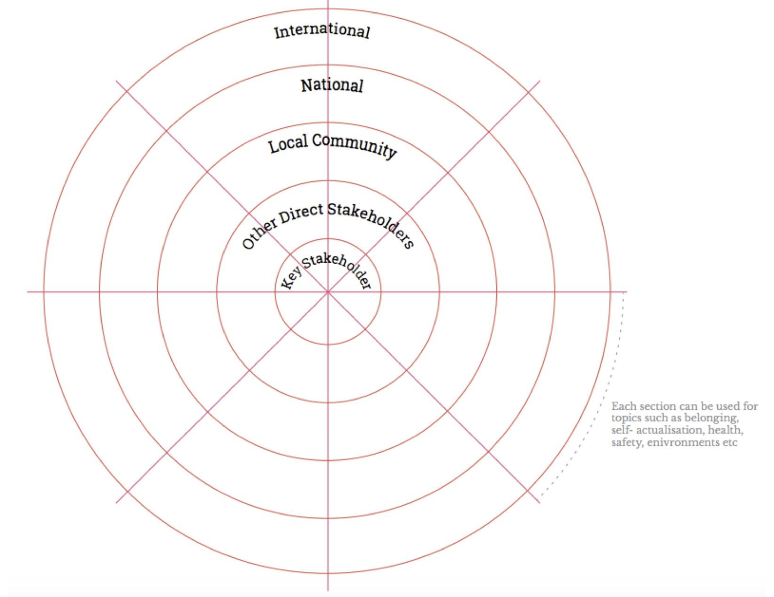
HCD for WASH
STAKEHOLDER MAPPING - TEMPLATE
Each cross-section can be used for topics such as belonging, self-actualization, health, safety, environment, etc.

